Slide 1

A look at HIV
Christian Choe

Slide 2
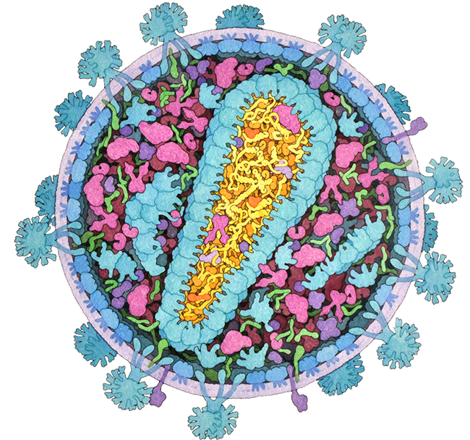
Structure of HIV

Slide 3
Symptoms
Fever
Headache
Sore Throat
Diarrhoea
Weight Loss
Coughing
Pneumonia

Slide 4
What does it actually do?
Break Helper T cells

Slide 5

Virulence
“the severity or harmfulness of a disease or poison.”

Slide 6
At risk from HIV
Gay/Bisexual men
Ethnic minorities
Women
Youth
People who inject drugs

Slide 7
Mode of Transmission

Slide 8
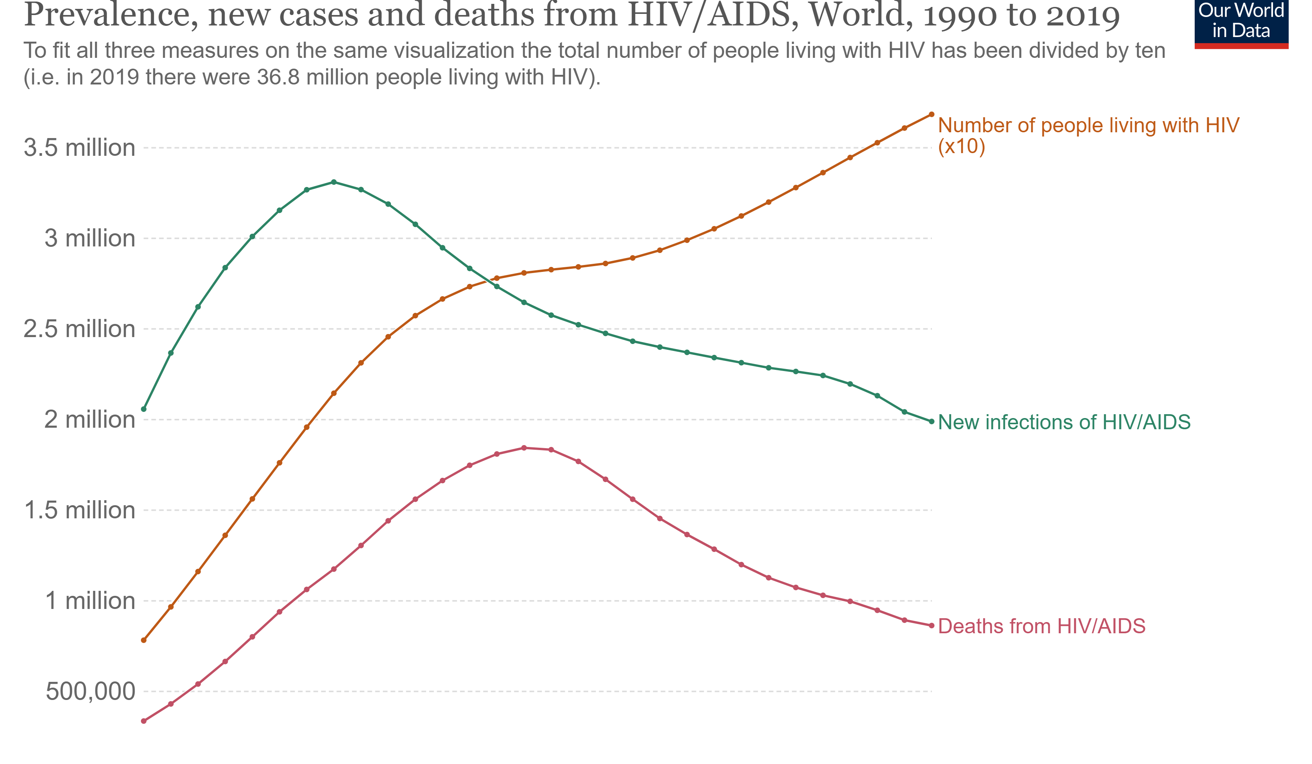
Graph analysis
Luckily, the new infections of HIV and AIDS peaked during 1995-2000, and the deaths peaked around 2005, but the number of people living with HIV continues to increase, albeit at a slower rate. To add to that, we can see that HIV is still a large problem within the world, with around 2 million new cases a year with just under 1 million deaths from AIDS-related complications.

Slide 9
Prevention
And treatment

Slide 10
Bibliography
ASHM. (n.d.). The Structural Biology of HIV. Retrieved 22 October 2022, from https://cdn.rcsb.org/pdb101/learn/resources/structural-biology-of-hiv/index.html
David Goodsell. (2000, June). PDB101: Molecule of the Month: HIV-1 Protease. RCSB: PDB-101. http://pdb101.rcsb.org/motm/6
David Goodsell. (2011, March). PDB101: Molecule of the Month: Integrase. RCSB: PDB-101. http://pdb101.rcsb.org/motm/135
David Goodsell. (2014, January). PDB101: Molecule of the Month: HIV Envelope Glycoprotein. RCSB: PDB-101. http://pdb101.rcsb.org/motm/169
David Goodsell. (2022, September). PDB101: Molecule of the Month: HIV Reverse Transcriptase. RCSB: PDB-101. http://pdb101.rcsb.org/motm/33
HIV.gov. (2022, June 15). Who Is at Risk for HIV? HIV.Gov. https://www.hiv.gov/hiv-basics/overview/about-hiv-and-aids/who-is-at-risk-for-hiv
Lymphocyte. (2022). In Wikipedia. https://en.wikipedia.org/w/index.php?title=Lymphocyte&oldid=1115796794
MedlinePlus. (2022a, August 22). CD4 Lymphocyte Count: MedlinePlus Medical Test. https://medlineplus.gov/lab-tests/cd4-lymphocyte-count/
MedlinePlus. (2022b, August 22). CD4 Lymphocyte Count: MedlinePlus Medical Test. https://medlineplus.gov/lab-tests/cd4-lymphocyte-count/
National Institute on Drug Abuse. (2012, July). Who Is at Risk for HIV Infection and Which Populations Are Most Affected? National Institute on Drug Abuse. https://nida.nih.gov/publications/research-reports/hivaids/who-risk-hiv-infection-which-populations-are-most-affected
RCSB Protein Data Bank. (n.d.-a). HIV structure and organisation. HIV Management Guidelines. Retrieved 22 October 2022, from https://hivmanagement.ashm.org.au/basic-hiv-virology/hiv-structure-and-organisation/
RCSB Protein Data Bank. (n.d.-b). The Structural Biology of HIV. Retrieved 23 October 2022, from https://cdn.rcsb.org/pdb101/learn/resources/structural-biology-of-hiv/index.html#
The Editors of Encyclopaedia Britannica. (n.d.). Helper T cell | Description & Function | Britannica. Retrieved 24 October 2022, from https://www.britannica.com/science/helper-T-cell
Wikipedia. (2021). CD4. In Wikipedia. https://en.wikipedia.org/w/index.php?title=CD4&oldid=1060744667
Wikipedia. (2022). T helper cell. In Wikipedia. https://en.wikipedia.org/w/index.php?title=T_helper_cell&oldid=1111368563

